Slide 1

Microsoft PowerPoint
Digital Accessibility Spring Clean-Up Day

Slide 2
Use High-Contrast Colors and Readable Fonts
Importance of High Contrast
High-contrast colors improve text visibility for all users including those with low vision and color blindness.
Readable Fonts Enhance Clarity
Using sans-serif fonts like Arial or Calibri reduce cognitive load and improves comprehension.
PowerPoint Accessibility Tips
Use built-in themes with strong contrast and ensure body text is at least 18pt font for readability.
High Contrast vs. Low Contrast
Sans-serif vs. Serif
24pt font vs. 12pt font

Slide 3
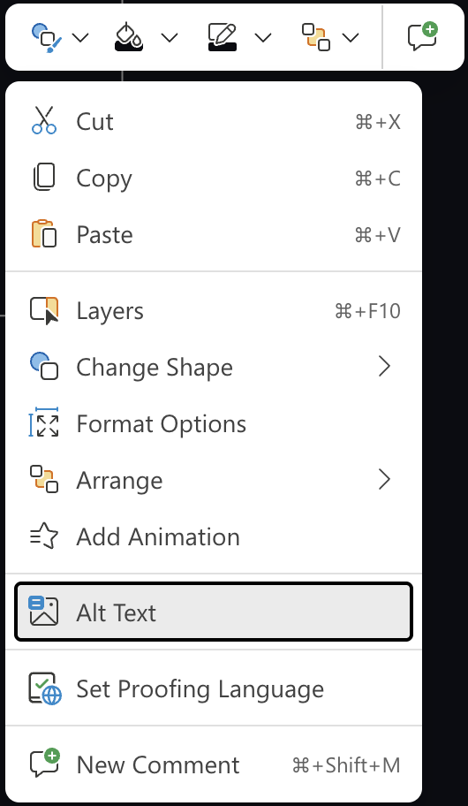

Add Alt Text for Images, Charts, and Graphics
Purpose of Alt Text: Alt text describes visuals for screen reader users, ensuring accessibility to all learners
Guidelines: Write concise, descriptive text focusing on the key message without using phrases like 'picture of...'
If an image does not convey meaning, or if the information can be found elsewhere on the slide, mark the image as decorative
Adding Alt Text in PowerPoint
Add alt text by right-clicking images and selecting 'Alt Text'
Handling Complex Visuals​
Use notes section or hide text off-screen to provide summaries for complex visuals that need more detailed descriptions.​
Be sure to add this to the reading order!
Notes:
Test

Slide 4
Ensure Logical Reading Order for Slide Elements
Importance of Logical Order
Logical reading order ensures screen readers present slide content clearly and coherently for all users.
Impact of Incorrect Order
Out-of-order elements confuse assistive technology users, reducing comprehension and usability.
Using PowerPoint Reading Order Pane
The Reading Order Pane helps verify and adjust reading order of slide elements easily.
Best Practices for Order
Arrange title, followed by body text, images, and other elements in a logical flow.

Slide 5
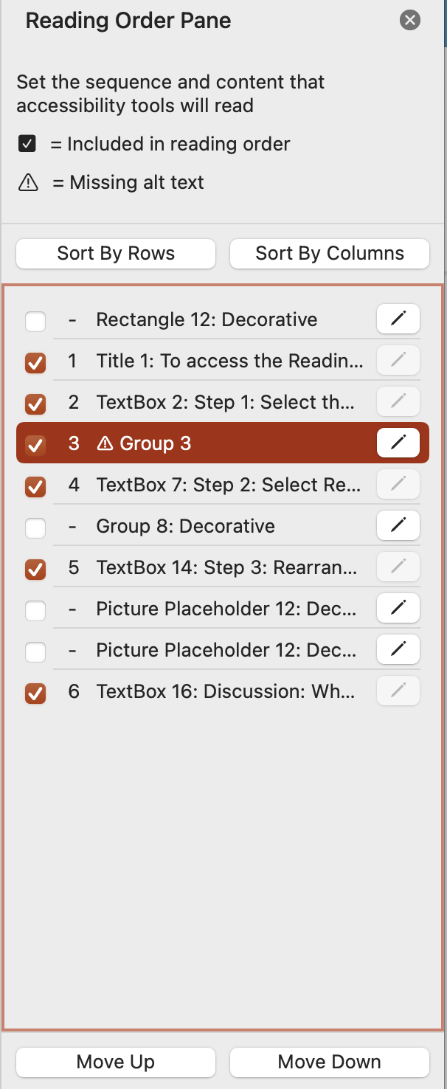
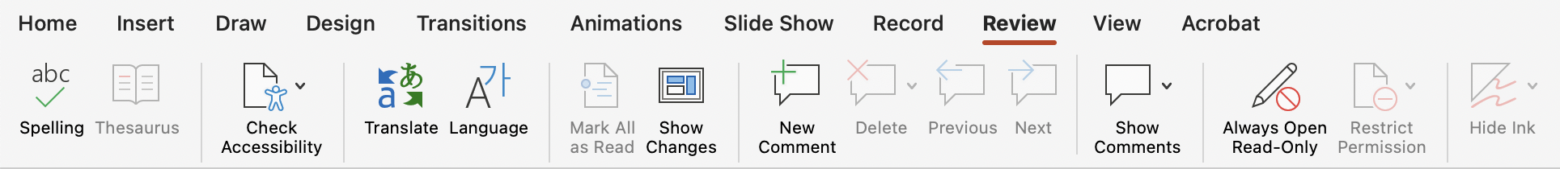
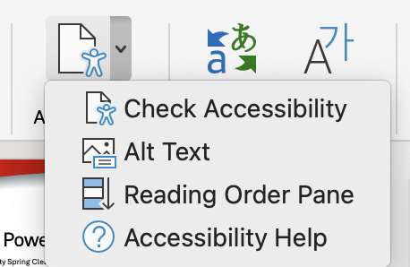
To access the Reading Order Pane:
Step 1: Select the Review tab, and click the arrow next to Check Accessibility
Step 2: Select Reading Order Pane from the dropdown menu
Step 3: Rearrange the items into a correct logical order for screen readers. You can add/edit alt text by clicking the pencil icon next to images. Uncheck items that are decorative or do not need to be read aloud for comprehension
Discussion: Why is this step necessary? What impact might a disordered slide have on the comprehension of learners who rely on screen readers?
Notes:
Notes go here

Slide 6

Provide Captions or Transcripts for Embedded Media
Importance of Captions​
Captions display spoken dialogue and sounds to support deaf or hard of hearing users in understanding video content.​
Role of Transcripts​
Transcripts provide a text version of audio or video content, making information accessible and searchable.​
Accessibility Benefits​
Providing captions and transcripts ensures compliance and benefits users in noisy environments or those preferring reading.​
[cc] closed captions...

Slide 7
Run the Accessibility Checker Before Sharing​
Purpose of Accessibility Checker​
The Accessibility Checker identifies potential issues and provides recommendations to improve presentation accessibility.​
Common Accessibility Issues​
It checks for missing alt text, low color contrast, and incorrect reading order in slides.​
Using the Accessibility Checker​
Navigate to Review tab, then select Check Accessibility to run and view issue details and fixes.​
Benefits of Running Checker​
Ensures inclusive design and prevents barriers for users with disabilities before
sharing presentations.​

Slide 8
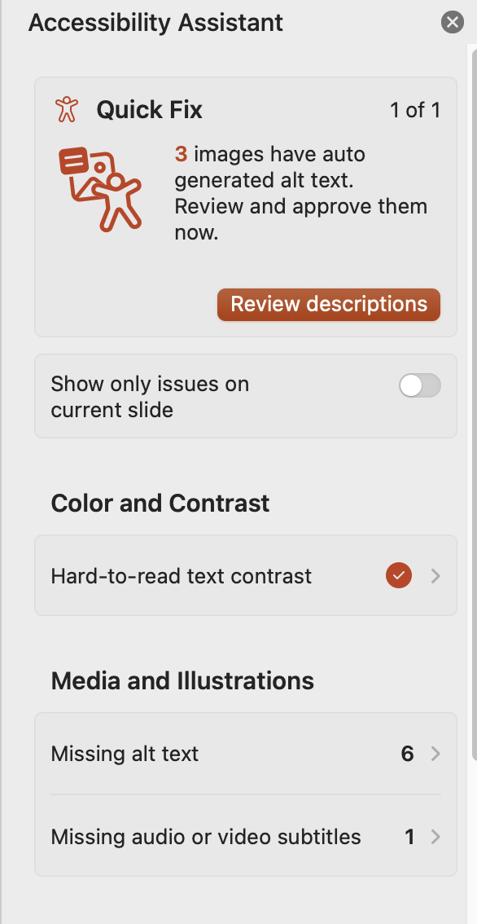
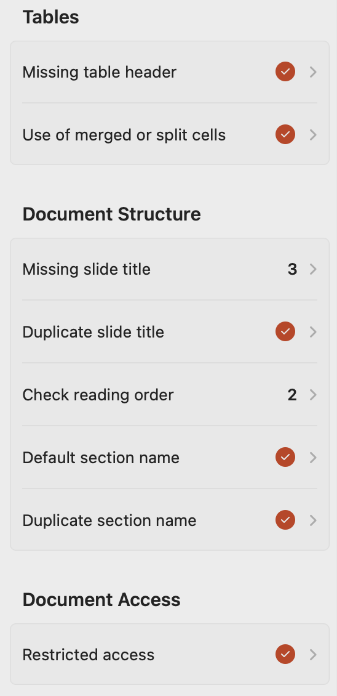
Accessibility Checker
Will show you the following information:
Notes:
Notes go here

Slide 9
Save/Export your Presentation Correctly
On a PC:
Use File > Export > Create PDF/XPS
In the options, select "Document structure tags for accessibility"
Check the option to Optimize for electronic distribution
This ensures screen readers and assistive tech can interpret it properly; embeds tags for navigation, links, and structure, making it accessible
On a Mac:
Use the File > Export menu
Select PDF as the format
Check the option for Best for electronic distribution and accessibility,
This action preserves tags and structure for screen readers and easy online sharing

Slide 10
Summary of PowerPoint Accessibility Best Practices
High Contrast and Fonts​: Use high-contrast colors and readable fonts to improve visibility for all viewers.​
Alt Text for Images​: Add descriptive alt text to images and graphics to assist screen reader users.​
Logical Reading Order​: Ensure a clear and logical sequence for reading slide elements to maintain clarity.​
Captions and Transcripts​: Provide captions or transcripts for all embedded media to support deaf or hard of hearing users.​
Accessibility Checker​: Run the Accessibility Checker to find and fix potential accessibility issues before sharing.​
Save your Presentation Correctly: Follow the proper steps to preserve the alt text, heading tags, and reading order you worked hard to create.
PowerPoint
Accessibility
Notes:
Notes go here

